Slide 1
CSE 299 Week 09 Fatin Fuad Karim I.D :1621197642 SEC : 03 Group: 06

Slide 2
GitHub Front Page

Slide 3
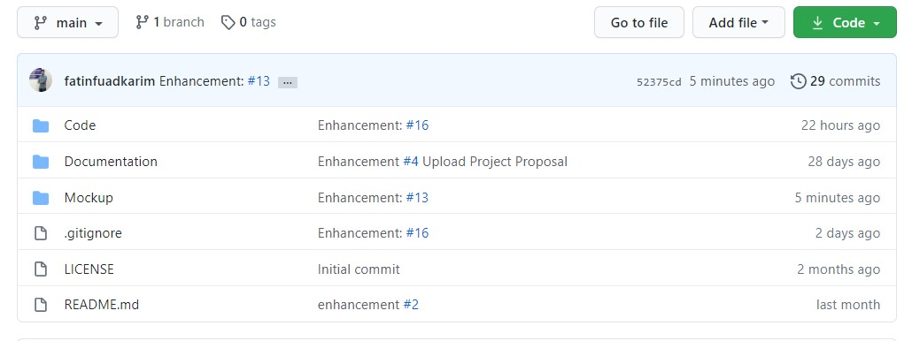

Slide 4
GitHub Board

Slide 5
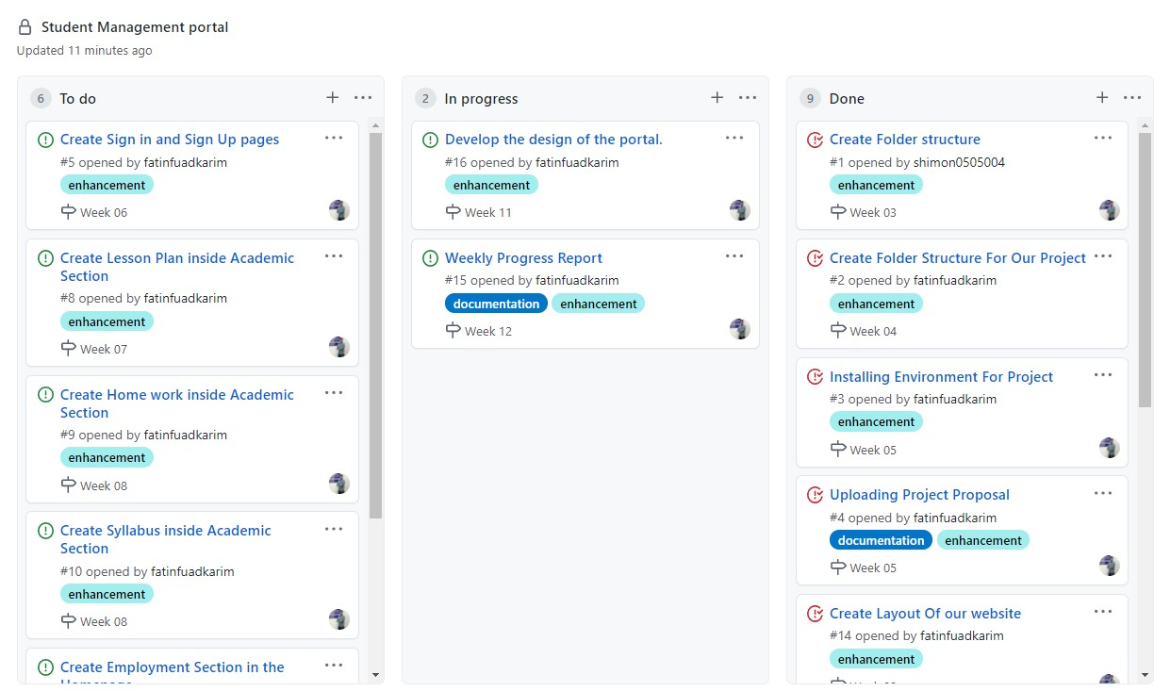

Slide 6
Issues

Slide 7
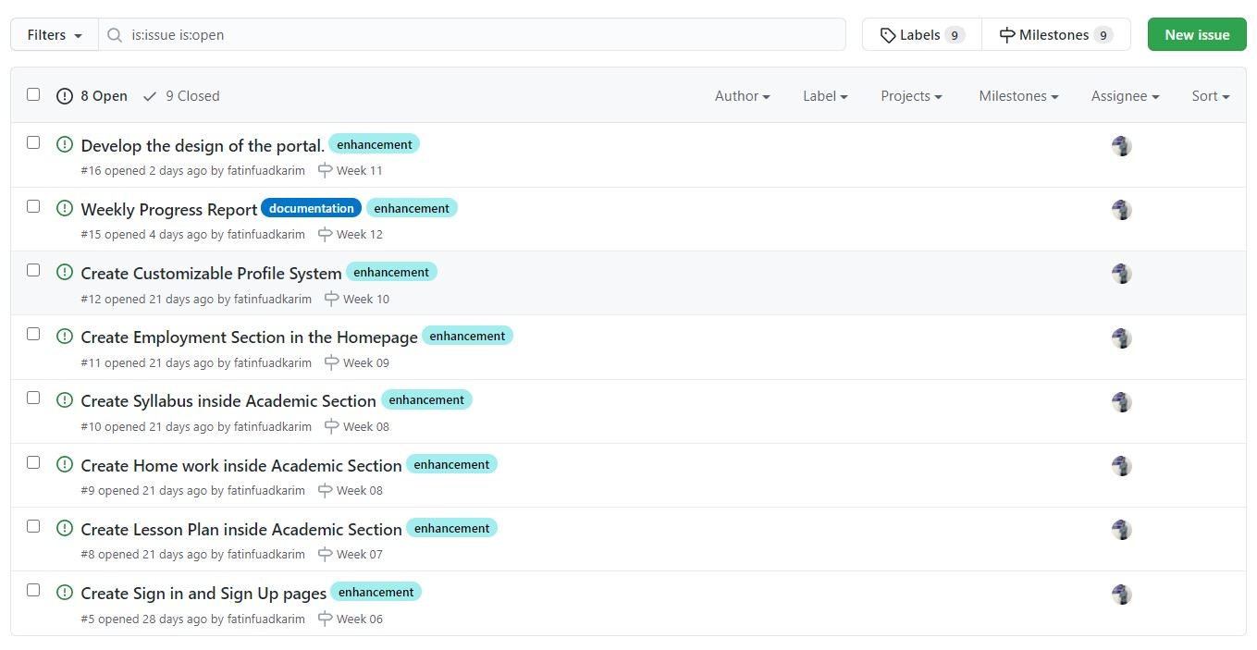

Slide 8
Milestones

Slide 9
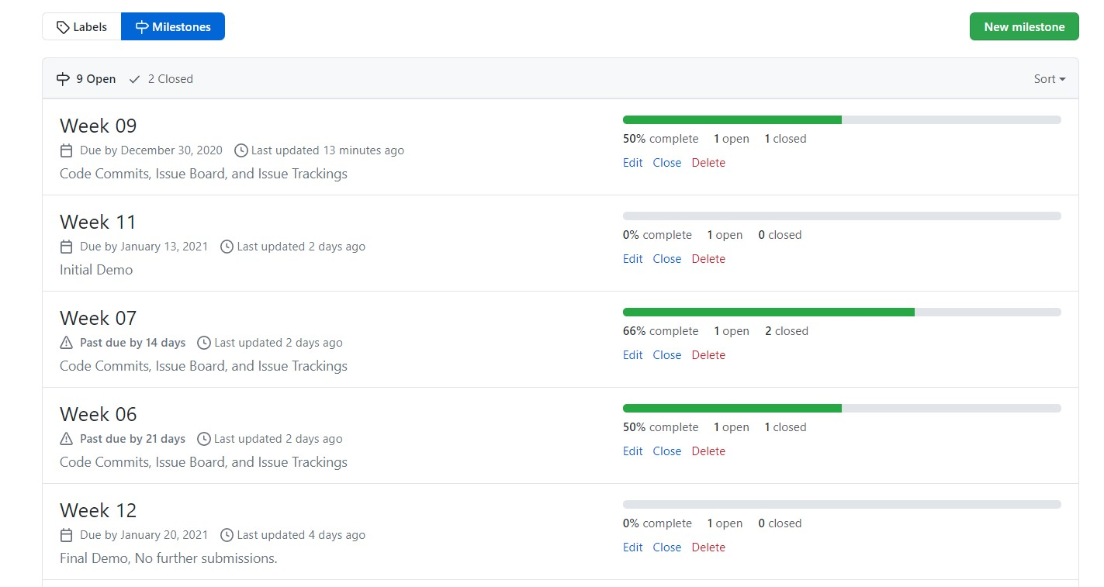

Slide 10
Local Repository

Slide 11
